Slide 1
PANDAS
Natalie, Eleanor, Patrick

Slide 2
Overview
Background
What/how to use it?
Important functions

Slide 3

Why was it created?
•Developed by Wes McKinney at AQR (Applied Quantitative Research) Capital in 2008, “out of the need for a high performance, flexible tool to perform quantitative analysis on financial data.”

Slide 4
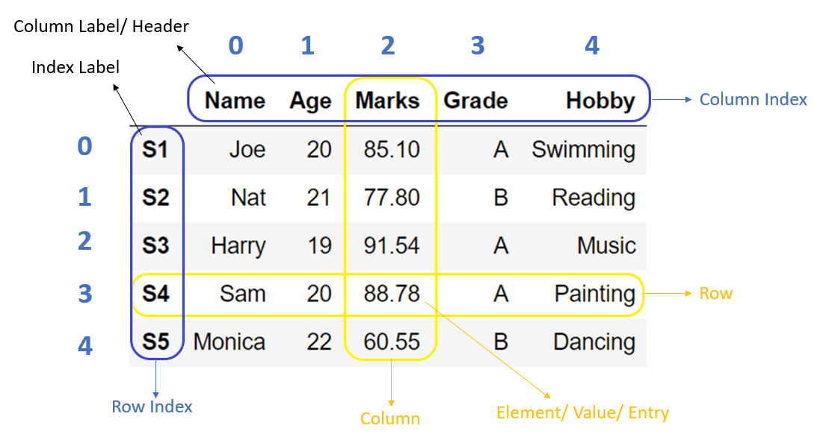
What is PANDAS good for?
•Data Science/Data Analysis and machine learning tasks
•DataFrame

Slide 5

Why is it good for this specific data?
Pandas, as a library, provide extended data structures to hold different types of labeled and relational data. This makes python highly flexible and extremely useful for manipulation and data cleaning.
Pandas is highly flexible and offers functions for performance operations like reshaping, joining, merging, and concatenating data.

Slide 6

What is PANDAS used for?
Generally:
Working with relational or labeled data
Provides high-level data structures and functions designed to make working with intuitive and flexible
Main tool for doing high level data analysis in Python

Slide 7


What can PANDAS do?
Parse Data
Handle time series data
Arithmetic that preserves the metadata
Merge and other general functions for data wrangling

Slide 8
Primary Objects
Series:
One dimensional labeled array object
Contains a sequence of values of the same type and an associate array of labels
Dataframes:
Tabular, column-oriented data structure with row and column labels
Indexes
Hold the axis labels (column names for a dataframe) and other metadata (axis name/names)
Notes:
objects are equipped with a set of common mathematical and statistical methods. Most of these fall into the category of reductions or summary statistics, methods that extract a single value (like the sum or mean) from a Series, or a Series of values from the rows or columns of a DataFrame.

Slide 9

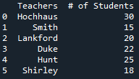
Creating a Dataframe in Python
Column 1 Data
Column 2 Data
Column 1 Name
Column 1 Data
Column 2 Name
Column 2 Data
Output

Slide 10
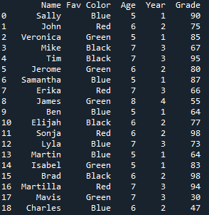
Import Dataframe
Location of the data set on your computer
Output

Slide 11

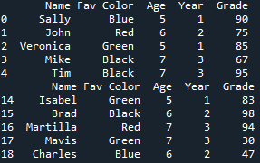
Viewing first and last five rows
First 5 rows
Last 5 rows
Output

Slide 12
Recalling the Names of the Columns
Output

Slide 13
Shape of the data
(# of rows & columns)
Size of the data
(rows x columns)
Output
Output

Slide 14
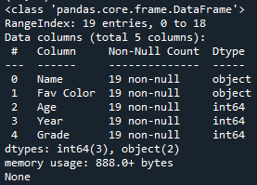
Information about the Data
Output
Range of the data
Number of Columns
Data type
Column Titles
Number of non-null values

Slide 15
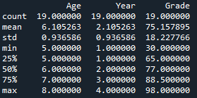
Basic Statistical Information
Output
# of data entries
Mean of each variable
Standard deviation
Minimum values
Quartiles
Maximum values

Slide 16

Amount of Null Values in the Data Set
Function to count the null values
Function to summarize the null values
Output

Slide 17




Slicing Data with loc (used with labels)
Specific variable
Data point
Information you want pulled
Specific variable
Data point

Slide 18


Slicing Data with iloc (used with integers)
Specific rows
Specific columns
Output

Slide 19
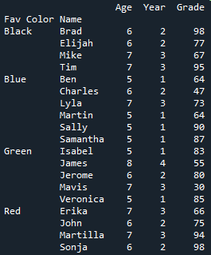
Grouping using groupby()
Function to group the variables
Sort first by favorite color and then by name
Writes all the rows in dataset
Output

Slide 20
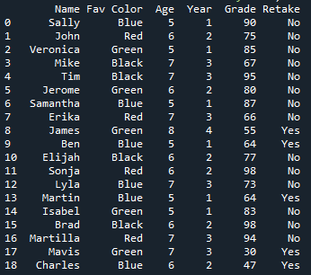
Creating an extra column and pre-populating Data
Name of new column
Variable the function is pulling information from
Function to create the new column
Allows you to create a function
Output
Function to populate the data for the new column
New column
Notes:
Lambda val allows you to create a function from a function

Slide 21

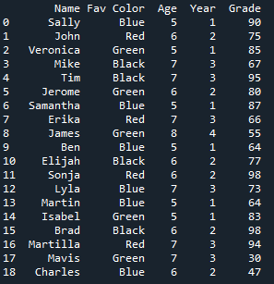
Deleting a Column or Row
Before
After
Column/row you want to delete
Specifies you want to delete a column
Deletes the column/row permanently from the dataframe

Slide 22
Conclusion
Background
What/how to use it?
Important functions

Slide 23
Thank you!
Any questions?

